Slide 1


Slide 2
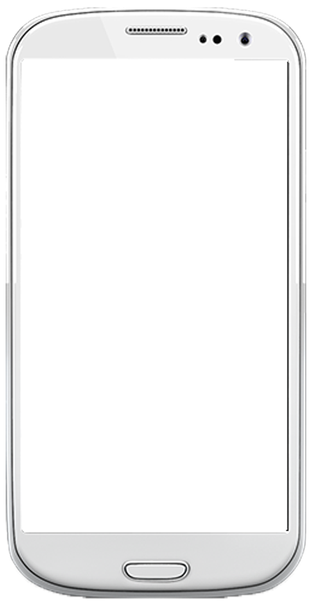


Slide 3
0.2 GPA Decline

Slide 4
High achieving students
who oversleep

Slide 5
Directly to high schools

Slide 6
<$20
COGS
$50
Revenue
70%
Profit Margin

Slide 7







Reliability
Cost

Slide 8

8500+ Engagement
500 Mailing Lists

Slide 9


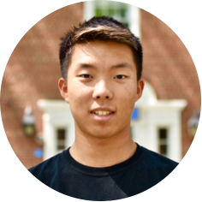

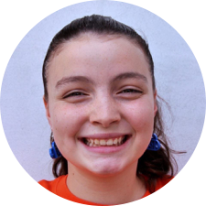
Areeba Aziz
Vicky Wang
David Sun
Leonardo Falanga
Valeria Cagnina

